Slide 1

Noida Institute of Engineering and Technology, Gr. Noida
Union Executive & State Executive
Unit: 4
Constitution of India, Law & Engineering
Ms. Annapurna Dwivedi
Assistant Professor, Department of MBA
Course Details (B. Tech 5th Semester)

Slide 2

Noida Institute of Engineering and Technology, Gr. Noida
Ms. Annapurna Dwivedi
Assistant Professor
Department: Management Studies
Email ID: annapurna.dwivedi@niet.co.in
Qualification: B.A. Economics hons.,PG Diploma in Finance, MBA Finance
Specialisation: Finance and HRM
Teaching experience: 1.5 years
Teaching Area: Finance and Marketing

Slide 3

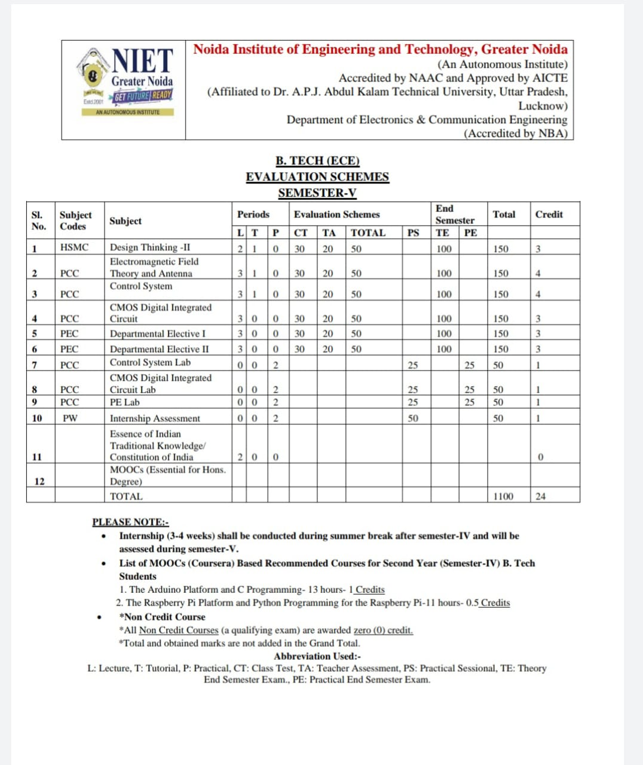
Evaluation Scheme

Slide 4

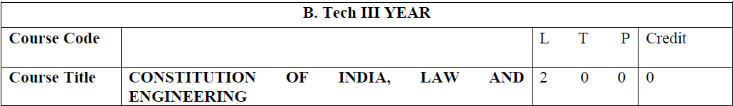
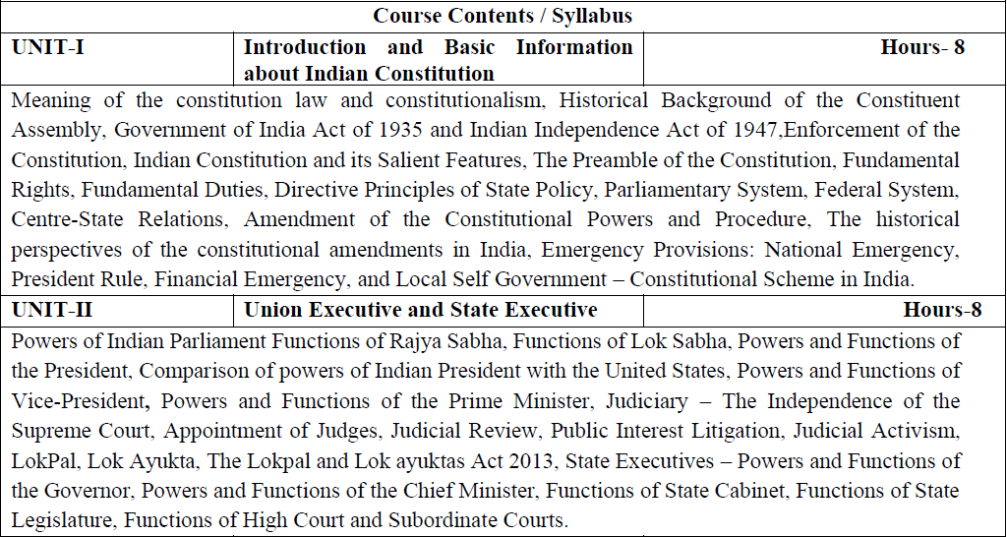
Syllabus

Slide 5

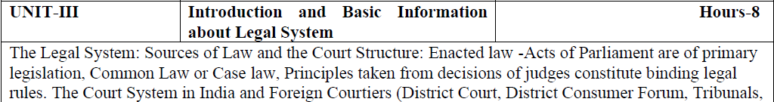
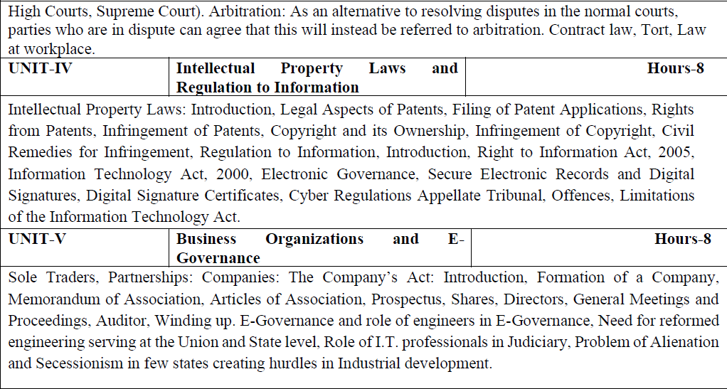
Syllabus

Slide 6

Branch wise Applications
Legal knowledge
Individual rights
Duties of a citizen
Patient filling
Business setup

Slide 7
Course Objectives
Course Objectives:
The student will try to learn about:
To acquaint the students with legacies of constitutional development in India and help those to understand the most diversified legal document of India and philosophy behind it.
To make students aware of the theoretical and functional aspects of the Intellectual Property Laws and Regulation to Information.
To channelize students’ thinking towards basic understanding of the legal concepts and its implications for engineers.
To acquaint students with latest intellectual property rights and innovation environment with related regulatory framework.
To make students learn about role of engineering in business organizations and e-governance.

Slide 8
Course Outcome (CO)
Course Outcome:
After successful completion of the course students will demonstrate the ability to
CO1: Identify and explore the basic features and modalities about Indian constitution.
CO2: Differentiate and relate the functioning of Indian parliamentary system at the center and state level.
CO3: Differentiate different aspects of Indian Legal System and its related bodies.
CO4: Discover and apply different laws and regulations related to engineering practices.
CO5: Correlate role of engineers with different organizations and governance models

Slide 9

Program Outcomes
Program Outcomes are narrow statements that describe what the students are expected to know and would be able to do upon the graduation.
These relate to the skills, knowledge, and behavior that students acquire through the programmed.
Engineering knowledge
Problem analysis
Design/development of solutions
Conduct investigations of complex problems
Modern tool usage
The engineer and society
Environment and sustainability
Ethics
Individual and team work
Communication
Project management and finance
Life-long learning

Slide 10
CO-PO Mapping
COs | POs | PO1 | PO2 | PO3 | PO4 | PO5 | PO6 | PO7 | PO8 | PO9 | PO10 | PO11 | PO12
CO1 |  | - | - | - | - | - | - | - | 3 | - | - | - | 3
CO2 |  | - | - | - | - | - | - | - | 3 | - | - | - | 3
CO3 |  | - | - | - | - | - | - | - | 3 | - | - | - | 3
CO4 |  | - | - | - | - | - | - | - | 3 | - | - | - | 3
CO5 |  | - | - | - | - | - | - | - | 3 | - | - | - | 3
Average |  | - | - | - | - | - | - | - | 3 | - | - | - | 3
Note: Correlation levels are taken 1, 2 and 3 as defined below:
1: Slight (Low) 2: Moderate (Medium) 3: Substantial (High)
If there is no correlation, put ‘-’

Slide 11
Program Specific Outcomes
Program Specific Outcomes (PSOs) are what the students should be able to do at the time of graduation. The PSOs are program specific. PSOs are written by the department offering the program.
PSO1: To apply the knowledge of mathematics, science and electronics & communication engineering to work effectively in the industry based on same or related area.
PSO2: To use their skills to work in modern electronics & communication engineering tools, software and equipments to design solutions for complex problems in the related field that meet the specified needs of the society.
PSO3: To function effectively as an individual and as a member or leader of a team by qualifying through examinations like GATE (Graduate Aptitude Test in Engineering), IES (Indian Engineering Services), PSUs (Public Sector Undertakings), TOEFL (Test of English as a Foreign Language), GMAT (Graduate Management Admission Test) and GRE (Graduate Record Examinations in US) etc.

Slide 12
CO-PSO Mapping
COs | PSOs | PSO1 | PSO2 | PSO3
CO1 |  | - | - | -
CO2 |  | - | - | -
CO3 |  | - | - | -
CO4 |  | - | - | -
CO5 |  | - | - | -
Average |  | - | - | -
Note: Correlation levels are taken 1, 2 and 3 as defined below:
1: Slight (Low) 2: Moderate (Medium) 3: Substantial (High)
If there is no correlation, put ‘-’

Slide 13
Program Educational Objectives
The Program Educational Objectives (PEOs) of an engineering degree program are the statements that describe the expected achievements of graduates in their career, and what the graduates are expected to perform and achieve during the first few years after graduation.
PEO1: To have an excellent scientific and engineering breadth so as to comprehend, analyze, design and solve real-life problems using state-of-the-art technology.
PEO2: To lead a successful career in industries or to pursue higher studies or to understand entrepreneurial endeavours.
PEO3: To effectively bridge the gap between industry and academics through effective communication skill, professional attitude and a desire to learn.

Slide 14
Result Analysis
Department wise:
OVERALL CLEAR PASS STUDENTS | 65
OVERALL PASS % | 48.51%
SUBJECT | KME501 | KME502 | KME503 | KME051 | KME055 | KAU051 | KAU052 | KME052 | KME056 | KME551 | KME552 | KME553 | KME554 | KNC501
NO.OF BACKLOGS | 30 | 47 | 7 | 1 | 3 | 8 | 16 | 0 | 10 | 0 | 0 | 0 | 0 | 0
BACKLOG % | 22.39% | 35.07% | 5.22% | 0.75% | 2.24% | 5.97% | 11.94% | 0.00% | 7.46% | 0.00% | 0.00% | 0.00% | 0.00% | 0.00%
PASS % | 77.61% | 64.93% | 94.78% | 99.25% | 97.76% | 94.03% | 88.06% | 100.00% | 92.54% | 100.00% | 100.00% | 100.00% | 100.00% | 100.00%

Slide 15
Result Analysis
Subject wise:
Subject Code | Subject Name | Total Student | Backlog Number | Pass %
KNC 502 | COILE | 135 | 0 | 100%

Slide 16
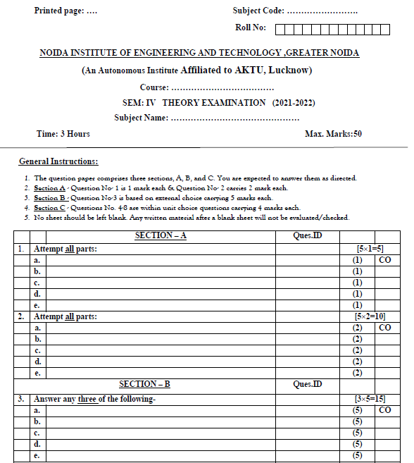
End Sem Question Paper Template

Slide 17
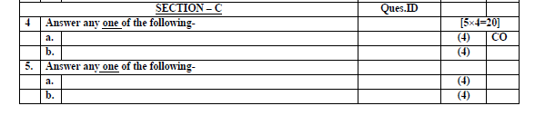
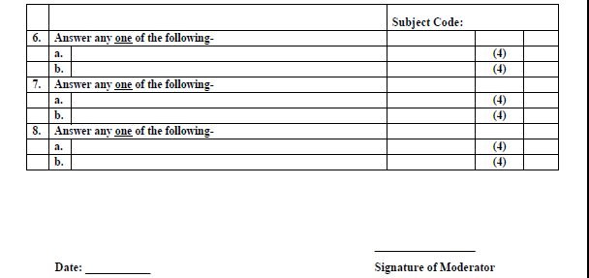
End Sem Question Paper Template

Slide 18
Prerequisite and Recap
Prerequisites:
Right to Information Act, 2005
Information Technology Act, 2000
Recap:
Electronic Governance

Slide 19
Brief Subject Introduction with Video
The intellectual property rights (IPR) are intangible in nature and gives exclusive rights to inventor or creator for their valuable invention or creation. In present scenario of globalization, IPR is the focal point in global trade practices and livelihood across the world. These rights boost the innovative environment by giving recognition and economic benefits to creator or inventor whereas the lack of IPR awareness and its ineffective implementation may hamper the economic, technical and societal developments of nation. Hence dissemination of IPR knowledge and its appropriate implementation is utmost requirement for any nation. The present paper highlights various terms of IPR such as patents, trademarks, industrial designs, geographic indications, copyright, etc. with their corresponding rules, regulations, their need and role especially pertaining to Indian context. Further, status of India’s participation in IPR related activities across the world has been discussed in brief.
https://www.youtube.com/watch?v=9C88NOP59gM

Slide 20
Contents
UNIT -IV
Intellectual Property Laws and Regulation to Information
Intellectual Property Laws: Introduction, Legal Aspects of Patents, Filing of Patent Applications, Rights from Patents, Infringement of Patents, Copyright and its Ownership, Infringement of Copyright, Civil Remedies for Infringement
Regulation to Information Introduction, Right to Information Act, 2005, Information Technology Act, 2000
Electronic Governance, Secure Electronic Records and Digital Signatures, Digital Signature Certificates, Cyber Regulations Appellate Tribunal, Offences, Limitations of the Information Technology Act.

Slide 21
Intellectual Property Laws: Introduction
Intellectual Property law deals with laws to protect and enforce rights of the creators and owners of inventions, writing, music, designs and other works, known as the "intellectual property." There are several areas of intellectual property including copyright, trademarks, patents, and trade secrets.
Intellectual property rights (IPR) refers to the legal rights given to the inventor or creator to protect his invention or creation for a certain period of time. These legal rights confer an exclusive right to the inventor/creator or his assignee to fully utilize his invention/creation for a given period of time.

Slide 22
Unit Objective
To make students aware of the theoretical and functional aspects of the Intellectual Property Laws.

Slide 23
Topic Objective/ Topic outcome
Name of Topic | Objective of Topic | Mapping with CO
Legal Aspects of Patents, Filing of Patent Applications, Rights from Patents, Infringement of Patents, Copyright and its ownership, Infringement of Copyright, Civil Remedies for Infringement | Students will be able to learn about Intellectual Property Laws | CO4

Slide 24

Legal Aspect of Patents
A patent is an exclusive right granted for an invention, which is a product or a process that provides, in general, a new way of doing something, or offers a new technical solution to a problem. To get a patent, technical information about the invention must be disclosed to the public in a patent application.
Legal aspects include protecting your intellectual property rights, including trademarking, copyrighting and protecting trade secrets.

Slide 25

Legal Aspects of Patents
While trying to patent an invention, the inventor must ensure that their design meets three basic requirements.
Novelty: For an invention to be considered a novelty, it has to be new.
Usefulness: For an invention to be considered useful it should be able to perform what it intends to while serving a useful purpose
Inventive or lacking obviousness: An Inventive patent is provided when a series of original steps are taken in the creation of an idea or product.

Slide 26
Filing of Patent Applications
Filing a patent application in the Indian Patent Office is the first step towards securing a patent to your invention in India.
To file a patent application, a set of forms has to be submitted to the patent office.
The most important factor in filing a patent application is preparing a patent specification.
Drafting a patent specification is a highly skilled job, which can be only preformed by persons who have both technical as well as patent law expertise.

Slide 27
Filing of Patent Application
Conceiving Your Invention
Patent Search & Drafting
Filing the Patent Application
Publication of the Application
Request for Examination
Request to the objections
Grant of Patent

Slide 28
Rights from Patents
A patent shall confer on its owner the following exclusive rights:
where the subject matter of a patent is a product, to prevent third parties not having the owner’s consent from the acts of making, using, offering for sale, selling, or importing for these purposes that product.
where the subject matter of a patent is a process, to prevent third parties not having the owner’s consent from the act of using the process, and from the acts of using, offering for sale, selling, or importing for these purposes at least the product obtained directly by that process.

Slide 29
Rights from Patents
Right to exploit the patent
Right to assign and license
Right to surrender the patent
Right before sealing
Right to apply for the patent of admission
Right in case of Infringement

Slide 30
Infringement of Patents
Patent Infringement means the violation of the exclusive rights of the patent holder.
If any person exercises the exclusive rights of the patent holder without patent owner’s authorization then that person is liable for patent infringement.
The following acts when committed without the consent of the patentee shall amount to patent infringement.
1) making, using, offering for sale, selling, importing the patented product.
2) using the patented process, or using, offering for sale, selling or importing the product directly obtained by that process.

Slide 31
Copyright and its Ownership
One of the most important concerns in copyright law is the determination of copyright ownership. The general rule is that the creator of the work is the owner of all copyright interests in the work. However, where two or more parties create a work together, copyright ownership becomes a more difficult issue.
Owners hold specific rights but not all rights.
Author is the copyright owner.
Employer maybe the copyright owner.
Copyrights can be transferred.
Copyright owners may allow public uses.

Slide 32
Infringement of Copyright
Copyright infringement is the use or production of copyright-protected material without the permission of the copyright holder.
Copyright infringement means that the rights afforded to the copyright holder, such as the exclusive use of a work for a set period of time, are being breached by a third party.
Copyright infringement is the use or production of copyright-protected material without the permission of the copyright holder.
Individuals and companies who develop new works register for copyright protection to ensure that they can profit from their efforts.
Other parties may be granted permission to use those works through licensing arrangements or buy the works from the copyright holder.

Slide 33
Civil Remedies for Infringement
Civil remedies: provide for injunctions, damages, interpretation of accounts, delivery and destruction of infringing copies and damages for conversion.
Interlocutory Injunctions.
Pecuniary Remedies
Anton Pillar Orders
Mareva Injunction

Slide 34
Civil Remedies for Infringement
Interlocutory injunction, i.e., a temporary injunction against infringement of copyrights till final disposal of the suit.
Anton Pillar order, i.e., an order permitting the copyright owner along with a Local Commissioner appointed by the Court to search the premises and seize the infringing goods.
John Doe order, i.e., cease and desist orders passed by the Court against unknown infringers. In such cases, the identity of the infringer is unknown to the Plaintiff and is referred to as “John Doe” till the identity becomes known

Slide 35
Lecture Related to Topic
Patents: https://www.youtube.com/watch?v=OKjyGKl4L9E
Copyright: https://www.youtube.com/watch?v=voEp7EmFa8c&t=4s
Civil Remedies: https://www.youtube.com/watch?v=PgXReqylglA

Slide 36
Weekly Assignment
Write about the legal aspects of patents.
Explain the various rights from patents.
Explain Infringement of Patents.
Elaborate Copyright and its ownership.

Slide 37
Daily Quiz
Copyright Act, came into force on:
a)1957
b)1999
c) 2000
d) 1970
2. Which of the following is Rights of a Copyright owner?
a) Publish their work and Perform their work in public
b) Translate and Broadcast their work
c) Prevent others from making use of unauthorized copyrighted work
d) All of the above
3. Which Section of Patents Act, 1970 deals with ?

Slide 38
Daily Quiz
a) Section 5 of the Patents Act, 1970
b) Section 6 of the Patents Act, 1970
c) Section 8 of the Patents Act, 1970
d) Section 20 of the Patents Act, 1970
4. Section 7 of the Patents Act, 1970 deals with
a) Provisional and Complete specifications
b) Revocation how made
c) Form of application
d) Publication of application

Slide 39
Topic Objective/ Topic outcome
Name of Topic | Objective of Topic | Mapping with CO
Regulation to Information, Introduction, Right to Information Act 2005, Information Technology Act, 2000 | Students will be able to learn about Intellectual Property Laws | CO4

Slide 40
Regulation to Information
The Right to Information (RTI) is an act of the Parliament of India which sets out the rules and procedures regarding citizens' right to information. It replaced the former Freedom of Information Act, 2002.
The Right to Information Act passed in 2005 extends to all states and union territories of India excepting the state of Jammu and Kashmir.
This act gives Indian citizens the right to access information about any public authority or institution, including non-government organizations substantially funded by the government.
The main aims of the RTI act are to provide clarity of information to the citizens of India, to contain corruption and to promote accountability in the working of every public authority.

Slide 41
Information Technology Act, 2000
The Information Technology Act, 2000 (also known as ITA-2000, or the IT Act) is an Act of the Indian Parliament (No 21 of 2000) notified on 17 October 2000. It is the primary law in India dealing with cybercrime and electronic commerce.
Secondary or subordinate legislation to the IT Act includes the Intermediary Guidelines Rules 2011 and the Information Technology (Intermediary Guidelines and Digital Media Ethics Code) Rules, 2021.
An Act to provide legal recognition for transactions carried out by means of electronic data interchange and other means of electronic communication, commonly referred to as "electronic commerce", which involve the use of alternatives to paper-based methods of communication and storage of information, to facilitate electronic filing of documents with the Government agencies and further to amend the Indian Penal Code, the Indian Evidence Act, 1872, the Bankers' Books Evidence Act, 1891 and the Reserve Bank of India Act, 1934 and for matters connected therewith or incidental thereto.

Slide 42
Information Technology Act, 2000
It shall extend to the whole of India and, save as otherwise provided in this Act, it applies also to any offence or contravention thereunder committed outside India by any person.
It shall come into force on such date as the Central Government may, by notification, appoint and different dates may be appointed for different provisions of this Act and any reference in any such provision to the commencement of this Act shall be construed as a reference to the commencement of that provision.

Slide 43
Information Technology Act, 2000
Nothing in this Act shall apply to, —
a negotiable instrument as defined in section 13 of the Negotiable Instruments Act, 1881;
a power-of-attorney as defined in section 1A of the Powers-of-Attorney Act, 1882;
a trust as defined in section 3 of the Indian Trusts Act, 1882;
a will as defined in clause (h) of section 2 of the Indian Succession Act, 1925 including any other testamentary disposition by whatever name called;
any contract for the sale or conveyance of immovable property or any interest in such property;
any such class of documents or transactions as may be notified by the Central Government in the Official Gazette.

Slide 44
Lecture related to Topic
Right to Information: https://www.youtube.com/watch?v=rDA6ydWqdlc
IT Act, 2000: https://www.youtube.com/watch?v=czDzUP1HclQ
RTI Act 2005: https://www.youtube.com/watch?v=sN97XBrQcfU

Slide 45
Weekly Assignment
Describe Right to Information Act
Describe Right to Information Act, 2005
Describe IT Act 2000

Slide 46
Daily Quiz
Which of the following does not come under “Information” under RTI Act 2005?
a) Log books
b) Circulars
c) File Notings in the Process
d) Data material held in any electronic form
2. The RTI Application is addressed to:
a) Chief Minister of State
b) Prime Minister of India
c) President of India
d) Public Information Officer
3. RTI Act, 2005, came into force on which of the following dates ?

Slide 47
Daily Quiz
a) 22nd June 2005
b) 12 October 2005
c) 15 June 2005
d) 15 August 2005
4. The Right to Information Act replaced which Act?
a) IT Act, 2000
b) Freedom of Information Act, 2002
c) Delimination Act, 2002
d) None of the above

Slide 48
Topic Objective/ Topic outcome
Name of Topic | Objective of Topic | Mapping with CO
Electronic Governance, Secure Electronic Records and Digital Signatures, Digital Signature Certificates, Cyber Regulations Appellate Tribunal, Offences, Limitations of the IT Act. | Students will be able to learn about Intellectual Property Laws | CO4

Slide 49
Electronic Governance
E-governance may be understood as the performance of the governance via the electronic medium in order to facilitate an efficient, speedy and transparent process of disseminating information to the public, and other agencies and for performing government administration activities.
It refers to the application of information technology to the processes of government functioning in order to bring more transparency, openness and resulting in less bureaucracy.
The term E-Government and E-Governance are inter related. In India, there are many e-initiatives taken by Central Government, various State Governments and Municipal Corporations. A few examples are:
Internet reservation facility by the Indian Railways.
Mandatory e-filing of income tax returns.
On-line registration of Limited Liability Partnership and Companies through Ministry of Corporate Affairs Portal.
e-Portal for pensioners to lodge their grievances.

Slide 50
Electronic Governance
5. DigiLocker: DigiLocker is a secure cloud based platform for storage, sharing and verification of documents and certificates. DigiLocker is one of the key initiatives under the Digital India programme.
6. Jeevan Pramaan: Jeevan Pramaan facilitates pensioners. It is AADHAR based Digital Life Certificate for Pensioners.
7. National Services Portal, India.gov.in has been launched for birth, death, marriage certificate etc.
8. e-Hospital Project/Online Registration System (ORS): The ORS portal is patient interface of e-hospital for citizens to book online appointment.

Slide 51
Electronic Governance
Legal recognition of electronic records. Where any law provides that information or any other matter shall be in writing or in the typewritten or printed form, then, notwithstanding anything contained in such law, such requirement shall be deemed to have been satisfied if such information or matter is—
(a) rendered or made available in an electronic form; and
(b) accessible so as to be usable for a subsequent reference.
Legal recognition of digital signatures. Where any law provides that information or any other matter shall be authenticated by affixing the signature or any document shall be signed or bear the signature of any person (hen, notwithstanding anything contained in such law, such requirement shall be deemed to have been satisfied, if such information or matter is authenticated by means of digital signature affixed in such manner as may be prescribed by the Central Government.

Slide 52
Electronic Governance
Explanation.—For the purposes of this section, "signed", with its grammatical variations and cognate expressions, shall, with reference to a person, mean affixing of his hand written signature or any mark on any document and the expression "signature" shall be construed accordingly.
Use of electronic records and digital signatures in Government and its agencies. (1) Where any law provides for—
the filing of any form. application or any other document with any office, authority, body or agency owned or controlled by the appropriate Government in a particular manner;
the issue or grant of any licence, permit, sanction or approval by whatever name called in a particular manner; (c) the receipt or payment of money in a particular manner,

Slide 53
Electronic Governance
then, notwithstanding anything contained in any other law for the time being in force, such requirement shall be deemed to have been satisfied if such filing, issue, grant, receipt or payment, as the case may be, is effected by means of such electronic form as may be prescribed by the appropriate Government.
(2) The appropriate Government may, for the purposes of sub-section (1), by rules, prescribe—
the manner and format in which such electronic records shall be filed, created or issued;
the manner or method of payment of any fee or charges for filing, creation or issue any electronic record under clause (a).

Slide 54
Secure Electronic Records & Secure Digital Signatures
Secure electronic record. Where any security procedure has been applied to an electronic record at a specific point of time. then such record shall be deemed to be a secure electronic record from such point of time to the time of verification.
Secure digital signature. If, by application of a security procedure agreed to by the parties concerned, it can be verified that a digital signature, at the time it was affixed, was—
(a) unique to the subscriber affixing it;
(b) capable of identifying such subscriber;

Slide 55
Secure Electronic Records & Secure Digital Signatures
(c) created in a manner or using a means under the exclusive control of the subscriber and is linked to the electronic record to which it relates in such a manner that if the electronic record was altered the digital signature would be invalidated, then such digital signature shall be deemed to be a secure digital signature.
Security procedure. The Central Government shall for the purposes of this Act prescribe the security procedure having regard to commercial circumstances prevailing at the time when the procedure was used, including—
the nature of the transaction;
the level of sophistication of the parties with reference to their technological capacity;
the volume of similar transactions engaged in by other parties;
the availability of alternatives offered to but rejected by any party;
the cost of alternative procedures; and
(f) the procedures in general use for similar types of transactions or communications.

Slide 56
Digital Signature Certificates
Certifying Authority to issue Digital Signature Certificate.
Any person may make an application to the Certifying Authority for the issue of a Digital Signature Certificate in such form as may be prescribed by the Central Government
Every such application shall be accompanied by such fee not exceeding twenty five thousand rupees as may be prescribed by the Central Government, to be paid to the Certifying Authority: Provided that while prescribing fees under sub-section (2) different fees may be prescribed for different classes of applicants'.

Slide 57
Digital Signature Certificates
(3) Every such application shall be accompanied by a certification practice statement or where there is no such statement, a statement containing such particulars, as may be specified by regulations.
(4) On receipt of an application under sub-section (1), the Certifying Authority may, after consideration of the certification practice statement or the other statement under subsection (3) and after making such enquiries as it may deem fit, grant the Digital Signature Certificate or for reasons to be recorded in writing, reject the application:
Provided that no Digital Signature Certificate shall be granted unless the Certifying Authority is satisfied that—

Slide 58
Digital Signature Certificates
the applicant holds the private key corresponding to the public key to be listed in the Digital Signature Certificate;
the applicant holds a private key, which is capable of creating a digital signature;
the public key to be listed in the certificate can be used to verify a digital signature affixed by the private key held by the applicant: Provided further that no application shall be rejected unless the applicant has been given a reasonable opportunity of showing cause against the proposed rejection.

Slide 59
Cyber Regulations Appellate Tribunal
Establishment of Cyber Appellate Tribunal. (1) The Central Government shall, by notification, establish one or more appellate tribunals to be known as the Cyber Regulations Appellate Tribunal. (2) The Central Government shall also specify, in the notification referred to in subsection (1), the matters and places in relation to which the Cyber Appellate Tribunal may exercise jurisdiction.
Composition of Cyber Appellate Tribunal. A Cyber Appellate Tribunal shall consist of one person only (hereinafter referred to as the Residing Officer of the Cyber Appellate Tribunal) to be appointed, by notification, by the Central Government.

Slide 60
Cyber Regulations Appellate Tribunal
Qualifications for appointment as Presiding Officer of the Cyber Appellate Tribunal. A person shall not be qualified for appointment as the Presiding Officer of a Cyber Appellate Tribunal unless he—
is, or has been. or is qualified to be, a Judge of a High Court; or
is or has been a member of the Indian Legal Service and is holding or has held a post in Grade I of that Service for at least three years.
Term of office The Presiding Officer of a Cyber Appellate Tribunal shall hold office for a term of five years from the date on which he enters upon his office or until he attains the age of sixty-five years, whichever is earlier

Slide 61
Cyber Regulations Appellate Tribunal
Salary, allowances and other terms and conditions of service of Presiding Officer. The salary and allowances payable to, and the other terms and conditions of service including pension, gratuity and other retirement benefits of. The Presiding Officer of a Cyber Appellate Tribunal shall be such as may be prescribed: Provided that neither the salary and allowances nor the other terms and conditions of service of the Presiding Officer shall be varied to his disadvantage after appointment.

Slide 62
Cyber Regulations Appellate Tribunal
Filling up of vacancies. If, for reason other than temporary absence, any vacancy occurs in the office n the Presiding Officer of a Cyber Appellate Tribunal, then the Central Government shall appoint another person in accordance with the provisions of this Act to fill the vacancy and the proceedings may be continued before the Cyber Appellate Tribunal from the stage at which the vacancy is filled.
Resignation and removal. (1) The Presiding Officer of a Cyber Appellate Tribunal may, by notice in writing under his hand addressed to the Central Government, resign his office: Provided that the said Presiding Officer shall, unless he is permitted by the Central Government to relinquish his office sooner, continue to hold office until the expiry of three months from the date of receipt of such notice or until a person duly appointed as his successor enters upon his office or until the expiry of his term of office, whichever is the earliest.

Slide 63
Cyber Regulations Appellate Tribunal
(2) The Presiding Officer of a Cyber Appellate Tribunal shall not be removed from his office except by an order by the Central Government on the ground of proved misbehavior or incapacity after an inquiry made by a Judge of the Supreme Court in which the Presiding Officer concerned has been informed of the charges against him and given a reasonable opportunity of being heard in respect of these charges.
(3) The Central Government may, by rules, regulate the procedure for the investigation of misbehavior or incapacity of the aforesaid Presiding Officer.
Orders constituting Appellate Tribunal to be final and not to invalidate its proceedings. No order of the Central Government appointing any person as the Presiding Officer of a Cyber Appellate Tribunal shall be called in question in any manner and no act or proceeding before a Cyber Appellate Tribunal shall be called in question in any manner on the ground merely of any defect in the constitution of a Cyber Appellate Tribunal.

Slide 64
Cyber Regulations Appellate Tribunal
Staff of the Cyber Appellate Tribunal.
The Central Government shall provide the Cyber Appellate Tribunal with such officers and employees as that Government may think fit
The officers and employees of the Cyber Appellate Tribunal shall discharge their functions under general superintendence of the Presiding Officer.
The salaries, allowances and other conditions of service of the officers and employees or' the Cyber Appellate Tribunal shall be such as may be prescribed by the Central Government.

Slide 65
Offences
Tampering with computer source documents. Whoever knowingly or intentionally conceals, destroys or alters or intentionally or knowingly causes another to conceal, destroy or alter any computer source code used for a computer, computer programme, computer system or computer network, when the computer source code is required to be kept or maintained by law for the time being in force, shall be punishable with imprisonment up to three years, or with fine which may extend up to two lakh rupees, or with both.
Explanation.—For the purposes of this section, "computer source code" means the listing of programmes, computer commands, design and layout and programme analysis of computer resource in any form.

Slide 66

Offences
Hacking with computer system.
Whoever with the intent to cause or knowing that he is likely to cause wrongful loss or damage to the public or any person destroys or deletes or alters any information residing in a computer resource or diminishes its value or utility or affects it injuriously by any means, commits hack:
Whoever commits hacking shall be punished with imprisonment up to three years, or with fine which may extend upto two lakh rupees, or with both.

Slide 67
Offences
Publishing of information which is obscene in electronic form. Whoever publishes or transmits or causes to be published in the electronic form, any material which is lascivious or appeals to the prurient interest or if its effect is such as to tend to deprave and corrupt persons who are likely, having regard to all relevant circumstances, to read, see or hear the matter contained or embodied in it, shall be punished on first conviction with imprisonment of either description for a term which may extend to five years and with fine which may extend to one lakh rupees and in the event of a second or subsequent conviction with imprisonment of either description for a term which may extend to ten years and also with fine which may extend to two lakh rupees.

Slide 68
Limitations of the IT Act
The I.T. Act, 2000 may cause a conflict of jurisdiction.
Electronic commerce is based on the system of domain names. The I.T. Act, 2000 does not address the issues relating to domain names, rights and liabilities of domain owners.
The I.T. Act, 2000 does not provide for the protection of Intellectual Property Rights as issues regarding copyrights and patents are very common in relation to computer programs and networks.
The offences covered and defined under the I.T. Act, 2000 are not exhaustive in nature. Since, with the advancements in technologies, computer programs and networks are constantly changing and evolving, and with this advancement, the nature of cybercrimes is also evolving. This Act does not cover various kinds of cybercrimes such as cyberstalking, cyber fraud, chat room abuse, theft of internet hours and many more.
The I.T. Act, 2000 has not addressed issues like privacy and content regulation, which is very necessary, considering the vulnerability internet poses.
Lastly, the main issue with this Act is its implementation. The I.T. Act, 2000 does not lay down any parameters for its implementation and regulations.

Slide 69
Daily Quiz
What is Intellectual Property and Intellectual Property Rights ?
How the Intellectual Property (IP) is categorized ?
What are the salient features of the Patents (Amendment) Act, 2002 ?
What is the procedure for obtaining patent ?
What is patent infringement ? Give its type?
What are infringing and non-infringing activities ?
What do you understand by the term copyright ? Who is the owner of a copyrighted work ?
What is copyright infringement ? What amounts to copyright infringement ?

Slide 70
Weekly Assignment
1. What is intellectual property ?
2. What is intellectual property rights ?.
3. What are the categories of Intellectual Property (IP) ?
4. What is patent ?.
5. What is the object behind granting patent ?
6. Who can apply for patent ?
7. Where are patent offices located in India

Slide 71
Weekly Assignment
1.What do you understand by the term copyright ?
2.Briefly describe the Information Technology Act, 2000. .
3.What is Electronic Governance (E-Governance) ?
4. What are the objectives of E-Governance ?
5What are the advantages of E-Governance ?
6.What are the disadvantages of E-Governance ?
7. What are the remedies for copyright infringement ?

Slide 72
Weekly Assignment
1.Discuss the various historical milestones and major issues connected to the making of the Constitution of India.
2.Describe the salient features of the Constitution of India .
3.Introduce the literary composition ( parts ,articles & schedule) of Constitution of India.
4.Explain the fundamental rights & duties conferred to us by the Constitution of India.
5.What is the main objectives of DPSP? Discuss.
6.Discuss center - state & state - state relationship in the light of articles 245,256,257 & 263.
7.Explain the emergency proclamation provisions provided in the Constitution of India. What do you mean by the financial emergency? How it can be countered?
8.What is article 356? Explain. 9.What are the ways we can amend the Constitution of India? Discuss major
9. amendments made since independence which you think has shaped our future?

Slide 73
Topic Links
You tube/other Video Links
https://www.youtube.com/watch?v=9C88NOP59gM
https://www.youtube.com/watch?v=RJHjw2GpWlY
https://www.youtube.com/watch?v=p6lgIYuVyNo

Slide 74
MCQ
Who are remove the judge of the Supreme Court?
a) Chief Justice of Supreme Court
b) Only the President
c) Only the Parliament
d) Both Parliament and President
2. The Governor of State is appointed by the President on the advice of the?
a) Prime Minister
b) Vice President
c) Chief Minister
d) Chief Justice
3. The President gives his resignation to the?
a) Chief Justice
b) Parliament

Slide 75
MCQ
c) Vice President
d) Prime Minister
4. The total number of members nominated by the President to the Lok Sabha and the Rajya Sabha is:
a) 16
b) 18
c) 14
d) 12

Slide 76
MCQ
1. Which Article authorizes the Parliament to form new States, and alter areas, boundaries or names of existing States?
Article
2
3
(d) Article 8 3
2.The Speaker can ask a member of the House to stop speaking and let another member speak. This phenomenon is known as
(a) yielding the floor
(b) crossing the floor.
(c) anti-defection
(d) decoram

Slide 77
MCQ
4. All-India Services come under Article:
(a) 310
(b) 312
(c) 316
(d) 319
5. What is the duration of 'zero hour' in Lok Sabha?
15 minutes
Half-an-hour
One hour
Not specified.
6. The State which bas the largest number of seats reserved for the Scheduled Tribes in Lok Sabha is
Bihar.
Gujarat.
(c) Uttar Pradesh.
(d) Madhya Pradesh.
7. Which of the following Constitutional posts is enjoyed for a fixed term?
(a) President
(b) Chief Justice
(c) Prime Minister
(d) Governor

Slide 78
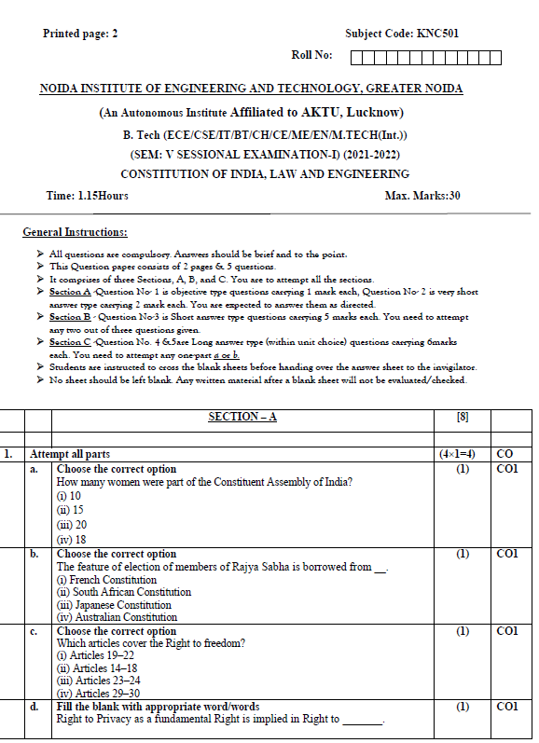
Sessional paper - I

Slide 79
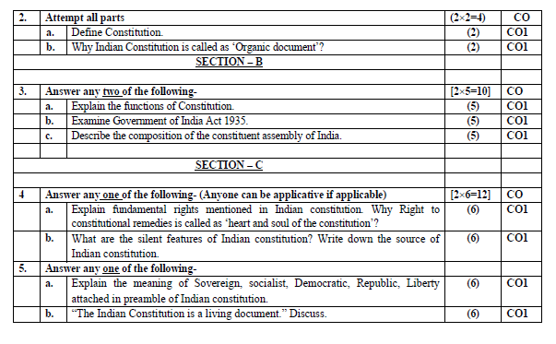
Sessional paper - I

Slide 80
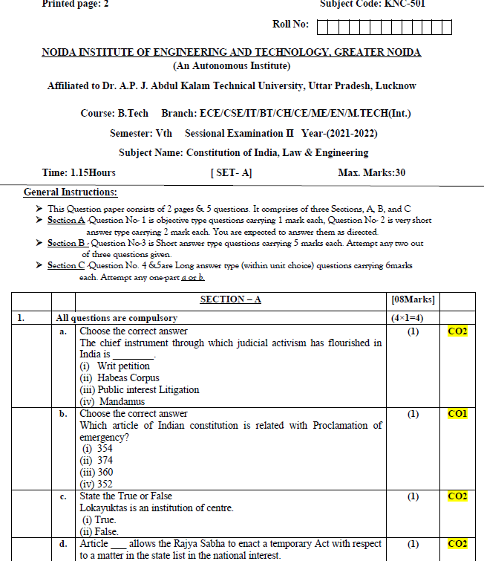
Sessional paper -II

Slide 81
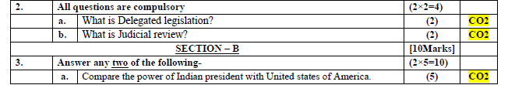
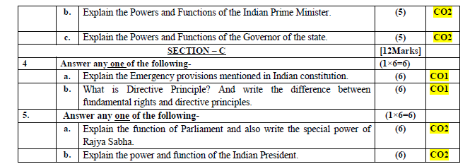
Sessional paper -II

Slide 82
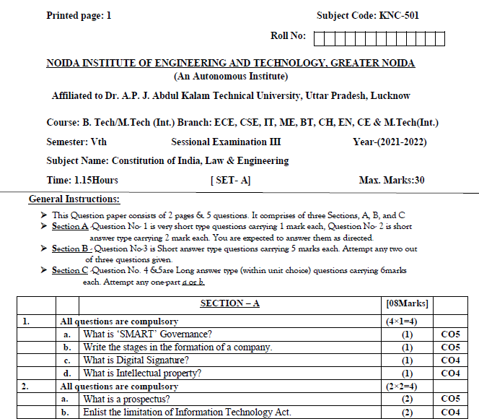
Sessional paper -III

Slide 83
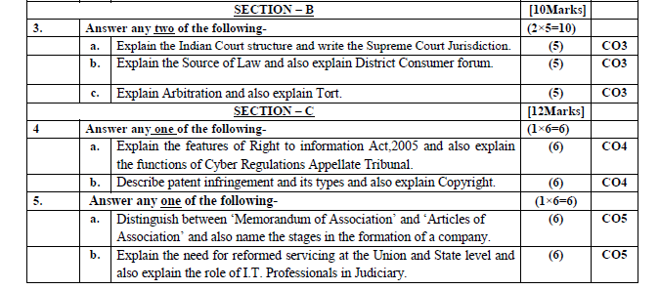
Sessional paper -III

Slide 84

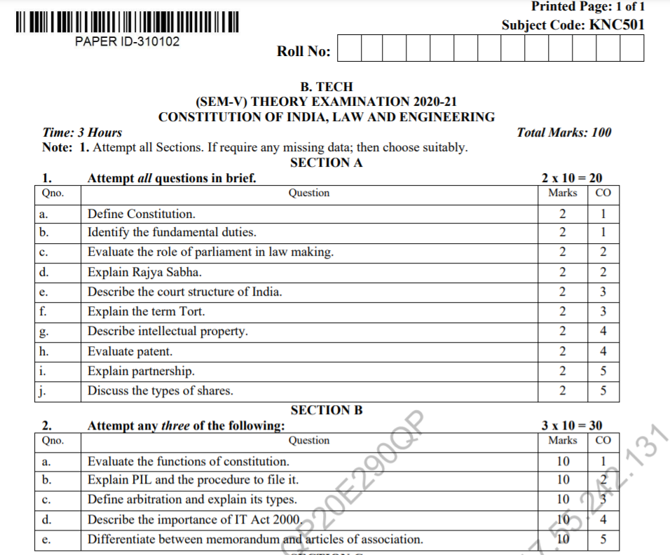
Old Question Papers

Slide 85
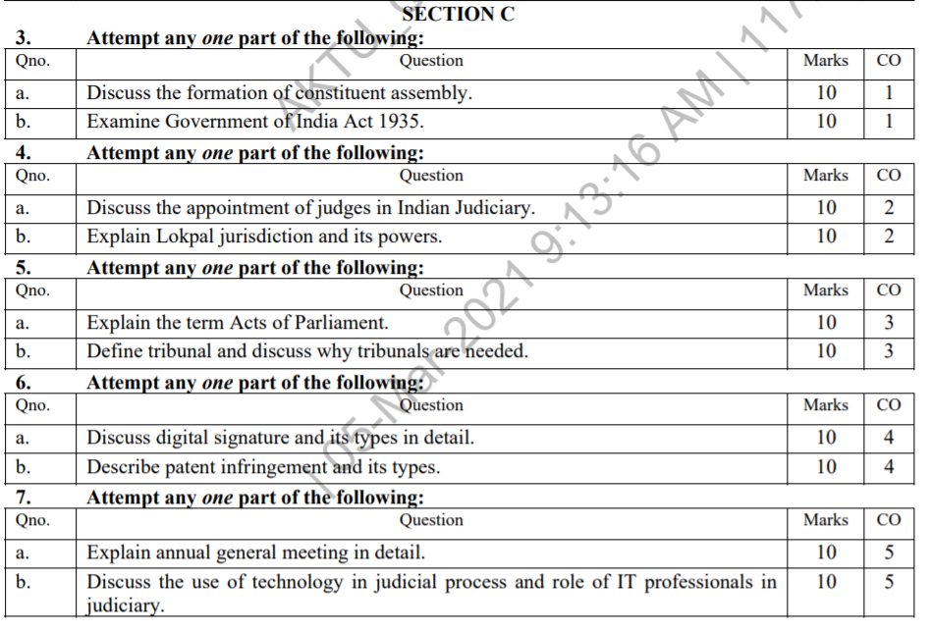
Old Question Papers

Slide 86
Expected Questions for University Exam
What are the powers of Indian Parliament?
Write a short note on Rajya Sabha (Council of States).
Who is the Supreme Commander of India’s armed forces?
On whose recommendations the members of the Council of Ministers appointed?
What is the procedure of removal of the President known as?
How many members of the Rajya Sabha are nominated by the President?
Mention one judicial power of the President.
What type of bills are invariably introduced in the Lok Sabha with the prior approval of the President?
Explain the method of election of the President.
Describe the qualifications for the office of the President of India. What is his and how can he be removed from office?

Slide 87

Expected Questions for University Exam
Compare the powers of Indian President with the United States President.
Write a short note on independence of Supreme Court.
Write a short note on Public Interest Litigation (PIL).
What do you mean by judicial activism? Also mention various methods of judicial activism which are followed in India.
What is Lokpal? Describe the structure of Lokpal.
What is Lok Ayukta? Describe the role of Lok Ayukta.
Explain the powers and functions of the Chief Minister?
What are the powers and functions of State Legislature?

